Slide 1
Denosumab – Wirksamkeit im gesamten Skelett*
*An allen gemessenen Skelettlokalisationen. In der FREEDOM-Studie wurden 7.808 Patientinnen über 3 Jahre mit Prolia® (Denosumab) versus Placebo
behandelt. Primärer Endpunkt waren neue Wirbelkörperfrakturen. Denosumab verminderte bei Frauen mit postmenopausaler Osteoporose und erhöhtem
Frakturrisiko signifikant das relative Risiko für neue Wirbelkörperfrakturen um 68%, für Hüftfrakturen um 40% und für nicht-vertebrale Frakturen um 20%.
Frakturen des Schädels, des Gesichts, der Mandibula, der Mittelhand und der Finger- und Zehenglieder wurden ausgeschlossen.
SC-AT-AMG162-00776 0821

Slide 2
Verlauf der Osteoporose im gesamten Skelett
Gliederung:
Die Bedeutung von kortikalem und trabekulärem Knochen
Behandlungseffekte auf trabekuläre und kortikale Knochenstrukturen
Wirksamkeit von Denosumab an verschiedenen Skelettlokalisationen
Zusatzfolien
Notes:
The purpose of this slide deck is to convey that osteoporosis affects sites of both trabecular and cortical bone throughout the skeleton; moreover, the incidence of fractures on these bone sites varies according to the age of the individual, coinciding with changes in the natural composition of bone that develop over time.
Treatments effects with denosumab and bisphosphonates on trabecular and cortical bone are reviewed in the second part of the slide deck
Additional slides are provided in the back up, in particular on bone strength

Slide 3
Die Bedeutung von kortikalem und trabekulärem Knochen
Notes:
Key Point
The purpose of this slide deck is to convey the key message that bone disease, in particular osteoporosis, occurs at sites of both trabecular and cortical bone throughout the skeleton; moreover, the effects on these bone sites varies according to the age of the individual, coinciding with changes in the natural composition of bone that develop over time.

Slide 4

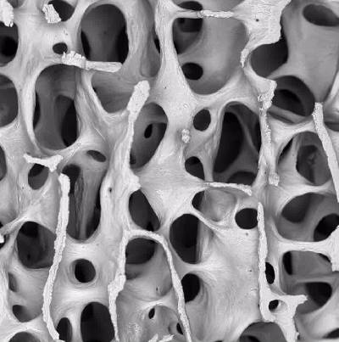
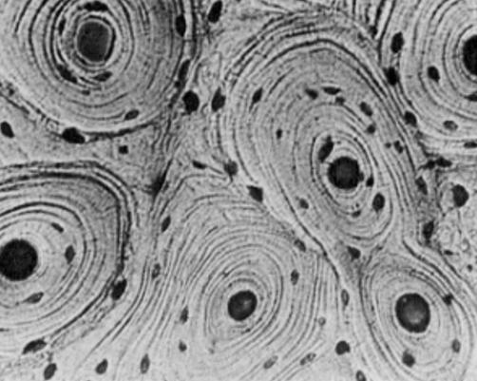
Trabekulärer und kortikaler Knochen
Ein schwammartiges Netzwerk zarter Knochenbälkchen (Trabekel)
20% der Skelettmasse
Höhere Umsatzrate als beim kortikalen Knochen
Dichte, äußere Hülle des Knochens; bestimmt die Knochenform
80% der Skelettmasse
Umsatzrate: 2-3% pro Jahr
Trabekulärer Knochen
Kortikaler Knochen
Dempster DW. Primer on the Metabolic Bone Diseases and Disorders of Mineral Metabolism.
6.Auflage 2006: 7-11; Bilder mit freundlicher Genehmigung von A. Boyd
Notes:
Key Point
This slide features a micro-CT image showing the structure of trabecular bone which forms the interior 20% of bone in the human skeleton.¹
Supplementary Information
This 20% trabecular (or cancellous) bone accounts for ~75% of total bone remodelling capacity.²
It forms an intricate scaffold of interconnecting plates, important both structurally and in metabolic processes ^{2,3}; with an essential role in mineral homeostasis due to its substantial surface area and rapid turnover rate. ⁴
Trabecular bone constitutes >65% of vertebral bone as its lattice structure is mechanically suited to withstand the compressive forces on the spinal column. ^{1,2,4,5}
Trabecular bone undergoes a coupled cycle of bone remodelling ⁶ :
Resorption erodes and thins the bone plates ⁶, followed by,
Formation through plate expansion and thickening, creating and renewing trabecular contacts. ^{6,7}
Remodelling rejuvenates bone, creating a net balance between bone loss and gain. ^{5,6}
1. Dempster DW. Primer on the Metabolic Bone Diseases and Disorders of Mineral Metabolism. 6th ed. 2006:7-11.
2. Patel S, et al. Drugs 1993;46(4):594-617.
3. Baron R. General Principles of Bone Biology. 5th ed. 2003:1-8.
4. Lindsay R and Cosman F. Treatment of the Postmenopausal Woman. 2nd ed. 1999:305-314.
5. Seeman E. N Eng J Med 2006;354:2250-2261.
6. Eriksen EF, et al. Bone Histomorphometry 1994: 13-20.
7. Seeman E. Osteoporos Int 2007;18:123-128.
Key Point
This slide features a micro-CT image of cortical bone, the dense exterior shell that defines the shape of human bone.¹
Supplementary Information
Structurally, cortical bone is composed of overlapping subunits called osteons, or Haversian systems, formed from concentric sheaths of mineralised collagen.^{1,2}
Osteons are longitudinally-oriented and irregularly interconnected, encompassing blood vessels, nerve fibres and a network of canals within their dynamic microenvironment.³
The interior surface of cortical bone is called the endosteum and is the primary site of remodelling and metabolic activities. ^{1,3}
The exterior surface is known as the periosteum and is the site of new bone formation (apposition).^{1, 3}
1. Dempster DW. Primer on the Metabolic Bone Diseases and Disorders of Mineral Metabolism. 6th ed. 2006:7-11.
2. Seeman E, Delmas PD. N Engl J Med 2006;354:2250-2261.
3. Seeman E. Osteoporos Int 2007;18:123-128.

Slide 5
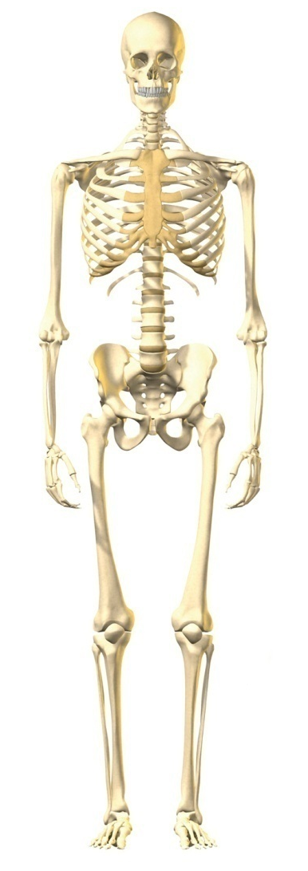
Der Anteil von kortikalen und trabekulären Knochenstrukturen unterscheidet sich je nach Skelettlokalisation
WIRBELSÄULE
trabekulär > kortikal
DISTALER RADIUS
kortikal > trabekulär
HÜFTE GESAMT
kortikal = trabekulär
Dempster DW. Primer on the metabolic bone diseases and disorders of bone metabolism. 6th ed. 2006; p.7–11.

Slide 6
Die Knochenmasse nimmt mit dem Einsetzen der Wechseljahre rasch ab
Aufbau der
maximalen Knochenmasse
Beginn der Menopause *
Maximale Knochenmasse
Knochenabbau
Formation
> Resorption
Knochenmasse
Resorption
>
Formation
0
10
20
30
40
50
60
70
80
Alter (Jahre)
Lanham-New SA. Proc Nutr Soc 2008;67:163−176; Burger H et al. Am J Epidemiol 1998;147:871−879;
Recker R et al. J Bone Miner Res 2000;15:1965−1973; Sambrook P. Bone structure and function in normal and disease states. Chapter 5; p.67–84; Weaver CM et al. Primer on the Metabolic Bone Diseases and Disorders of Mineral Metabolism. 7th ed. 2008:206−208.

Slide 7
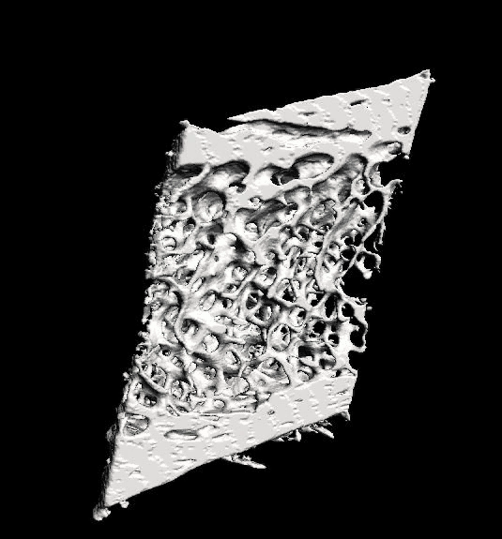
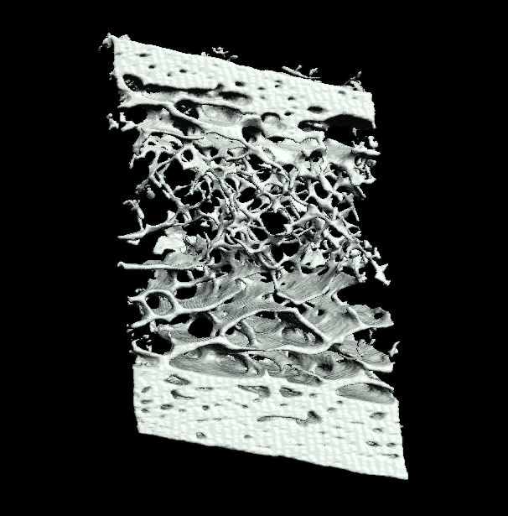
Kurz nach der Menopause verlieren Frauen in erster Linie trabekulären Knochen
Baseline
Nach einem Jahr
Dufresne TE et al. Calcif Tissue Int, 73: 423-432 (2003)
Zebaze RM et al. Lancet 2010:9727:1729-1736.

Slide 8
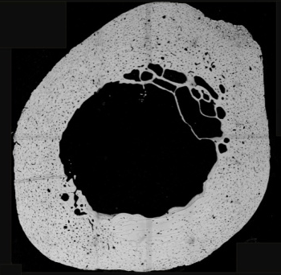
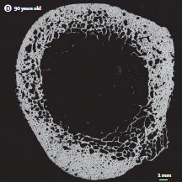
Die kortikale Porosität nimmt mit dem Alter zu
29-jährige Frau
90-jährige Frau
© 2010 Elsevier Ltd. Reproduced with permission from: Zebaze RMD, Ghasem-Zadeh A, Bohte A, et al. Intracortical remodelling and porosity in the distal radius and post-mortem femurs of women: a cross-sectional study. The Lancet 2010; 375: 1729-1736. &
© 2010 Elsevier Ltd. Reproduced with permission from: Zebaze RMD, Ghasem-Zadeh A, Bohte A, et al. Supplementary webappendix to: Intracortical
remodelling and porosity in the distal radius and post-mortem femurs of women: a cross-sectional study. The Lancet 2010; 375: 1729-1736. [online] Available at: http://www.thelancet.com/journals/lancet/article/PIIS0140-6736(10)60320-0
Notes:
Key Point
Post-mortem specimens of distal radius from women aged 29, 63 and 90 years¹
Increased bone resorption, particularly following the menopause, results in increased porosity of cortical bone.¹
Supplemental Information
A rapid rate of remodelling combined with an increased imbalance in the bone multicellular unit (the mechanism responsible for balanced bone resorption and formation) accelerates bone loss and structural decay after menopause.¹
With age, active cortical remodelling “trabecularizes” cortical bone (i.e. creates cortical bone with more surface area available for bone resoprtion) resulting in bone loss becoming mainly cortical in origin.¹
Cortical thinning and porosity also reduces the resistance of bone to the creation of microcracks.¹
Pores coalesce to form cortical bone with a sponge-like appearance, and the reduced bone mass is unable to withstand the energy imparted by a fall,¹ leading to fracture.
Reference
1. Zebaze RM et al. Lancet 2010:9727:1729−1736.

Slide 9
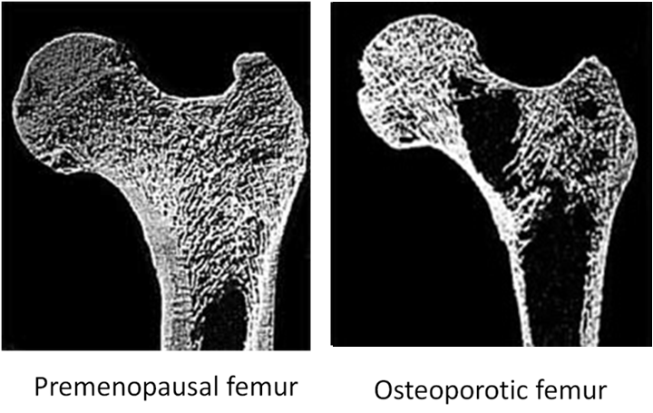
Nach Verlust trabekulärer Knochenstrukturen wird der kortikale Knochen für die Knochenfestigkeit noch wichtiger
Intakter trabekulärer Knochen
Destruktion des trabekulären Knochens
Prämenopausaler Femur Osteoporotischer Femur
Zebaze RM et al. Lancet 2010:9727:1729−1736,
Pistoia W et al. Bone 2003;33(6):937−945.
Notes:
Key Point
In the initial phases following the menopause, bone loss if primarily trabecular;¹ consequently, the remaining cortical bone may have an increasingly important role in maintaining bone strength.
Supplemental Information
Metabolic bone diseases, such as osteoporosis, usually cause a decrease in bone mass and a deterioration of bone microarchitecture that leads to a decline in bone strength.²
As the bone loss in the years immediately following the menopause is mainly trabecular,¹ the remaining cortical bone may become even more important in terms of bone strength maintenance.
Reference
1. Zebaze RM et al. Lancet 2010:9727:1729−1736.
2. Pistoia W et al. Bone 2003;33(6):937−945.

Slide 10
Kortikaler Knochen wird vermehrt im höheren
Alter abgebaut
90
50,2
Kortikaler Knochen
80
*
70
Trabekulärer Knochen
60
Mittlerer Knochenverlust am distalen Radius (mg Hydroxylapatit)
*p<0,0001
50
22,9
14,6
40
9,7
*
30
7,3
20
1,7
10
0
50−64 Jahre
65-79 Jahre
≥ 80 Jahre
Der schnelle Knochen-masseverlust nach der Menopause ist hauptsächlich trabekulär
Im Alter von
65 –79 Jahren ist der Knochenmasse-verlust
hauptsächlich
kortikal
Bei über 80-Jährigen sind 90 % der Abnahme an Knochenmasse kortikal
Zebaze RM. et al, Lancet 2010:9727: 1729-36
Notes:
Key Point
Cortical bone with its slower turnover is less sensitive to changes in bone formation and resorption and will be lost to a significant level later after menopause.¹
In late menopause (after the age of 65 and even more so after the age of 80) the majority of the bone lost is cortical¹
Supplemental information:
Data represented are mean bone loss values versus pre-menopausal women (33 women age 27 to 49)
References
Zebaze RM et al. Lancet 2010:9727:1729−1736

Slide 11
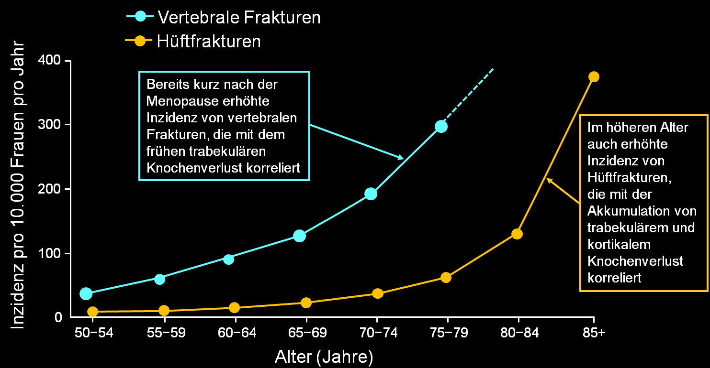
Mit der Progression des trabekulären und kortikalen Knochenabbaus nehmen Wirbel-
und Hüftfrakturen exponentiell zu
  Modifiziert nach: Sambrook P Lancet 2006;367:2010–2018.
Notes:
Key Points
In women aged >50 years fractures occur throughout the skeleton and the incidence accelerates with ageing.¹
Supplemental Information
Osteoporotic fractures occur throughout the skeleton; the most common fractures are those of the hip, spine and wrist.²
The incidence of all osteoporotic fractures increases with age.^{1,3}
Epidemiological studies have shown, for women aged >50 years, the most common fractures are hip (26% of all fractures) and vertebral (15%).³
In women, the incidence of hip fracture (a bone site comprised of >75% cortical bone)⁴ – the most devastating result of osteoporosis in terms of hospitalization, disability and mortality – increases exponentially from the age of approximately 50 years.¹
The incidence of vertebral fractures (a site comprised of ~70% trabecular bone)⁴ is high following the menopause and accelerates beyond the age of 50 years.¹
References
1. Sambrook P & Cooper C. Lancet 2006;367:2010–2018.
2. Johnell O & Kanis JA. Osteoporos Int 2006;17:1726–1733.
3. Kanis JA et al. Osteoporos Int 2005;16:229–238.
4. Dempster DW. Primer on the metabolic bone diseases and disorders of bone metabolism. 6th ed. 2006; p.7–11.

Slide 12
Zusammenfassung:
Verlauf der Osteoporose im gesamten Skelett
Die Knochenmasse nimmt mit dem Einsetzen der Wechseljahre rasch ab
  Anfänglicher Knochenschwund ist vor allem trabekulär¹
  Später nach der Menopause ist der Knochenschwund vor allem kortikal, verbunden mit einer erhöhten kortikalen Porosität¹
Die Inzidenz von vertebralen Frakturen ist nach der Menopause hoch und nimmt mit der Zeit kontinuierlich zu³
Die Inzidenz der Hüftfrakturen ist bis zum Alter von etwa 75 Jahren gering, danach erhöht sie sich dramatisch³
Der zeitliche Verlauf der Frakturinzidenz scheint mit trabekulärem und kortikalem Knochenverlust zu korrelieren
Nach Verlust der trabekulären Knochenstrukturen wird der verbleibende kortikale Knochen für die Knochenfestigkeit noch wichtiger²
1. Zebaze RM et al. Lancet 2010:9727:1729−1736;
2. Pistoia W et al. Bone 2003;33(6):937−945;
3. Sambrook P Lancet 2006;367:2010–2018

Slide 13
Behandlungseffekte auf trabekuläre und kortikale Knochenstrukturen
Notes:
Key Point
The purpose of this slide deck is to convey the key message that bone disease, in particular osteoporosis, occurs at sites of both trabecular and cortical bone throughout the skeleton; moreover, the effects on these bone sites varies according to the age of the individual, coinciding with changes in the natural composition of bone that develop over time.

Slide 14
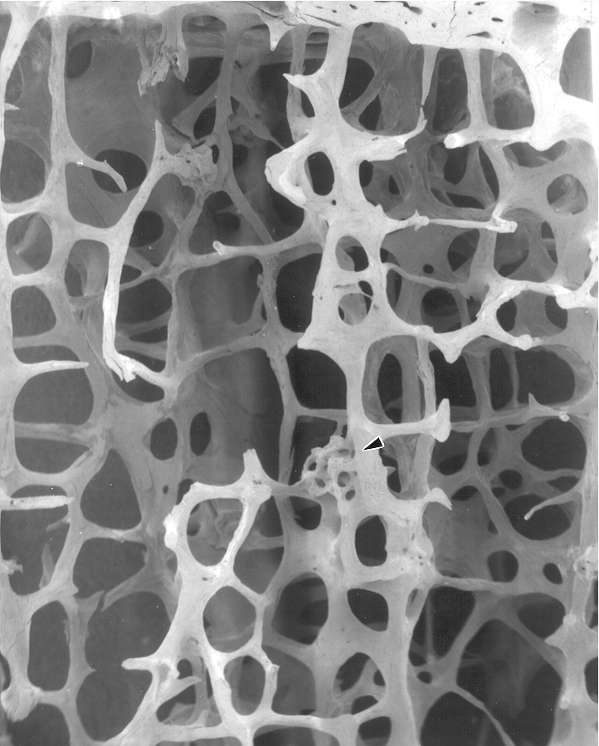
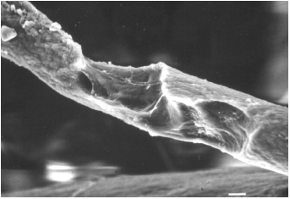
Unterschiede in der Knochenresorption
Trabekuläres Kompartiment
Mehr Oberfläche pro Volumen
Kortikales Kompartiment
Weniger Oberfläche pro Volumen
Osteoklasten erodieren zugängliche Oberflächen und entfernen trabekuläre Strukturen
Osteoklasten durchtunneln den Kortex und erhöhen die kortikale Porosität
Sambrook P. Bone structure and function in normal and disease states. Chapter 5; p.67–84; Clarke B. Clin J Am Soc 2008;3:S131–S139; Dempster DW. Primer on the metabolic bone diseases and disorders of bone metabolism. 6th ed. 2006; p.7–11.; Chavassieux P et al. Endocr Rev 2007; 28:151–164.
Notes:
Key Point
Whereas trabecular bone accounts for the minority of total skeletal tissue (20%), it is the site of greater bone turnover because its total surface area is greater than that of cortical bone.¹
Supplementary Information
Cortical bone is found principally in the diaphyses of long bones and consists of a number of irregularly spaced overlapping cylindrical units termed Haversian systems.^{1,2}
This type of bone is dense and solid, and less metabolically active than trabecular bone, with a turnover rate of approximately 2–3% per year.³
Trabecular bone, which has a higher turnover rate than cortical bone,¹ is structured like a porous sponge that functions like a spring.³
This type of bone is light and favours flexibility over stiffness.⁴
Although the skeleton has less trabecular bone than cortical bone, because trabecular bone ‘turns over’ between 3–10 times more rapidly than cortical bone, it is more sensitive to changes in bone resorption and formation.¹
References
1. Sambrook P. Bone structure and function in normal and disease states. Chapter 5; p.67–84.
2. Clarke B. Clin J Am Soc 2008;3:S131–S139.
3. Dempster DW. Primer on the metabolic bone diseases and disorders of bone metabolism. 6th ed. 2006; p.7–11.
4. Chavassieux P et al. Endocr Rev 2007; 28:151–164.

Slide 15
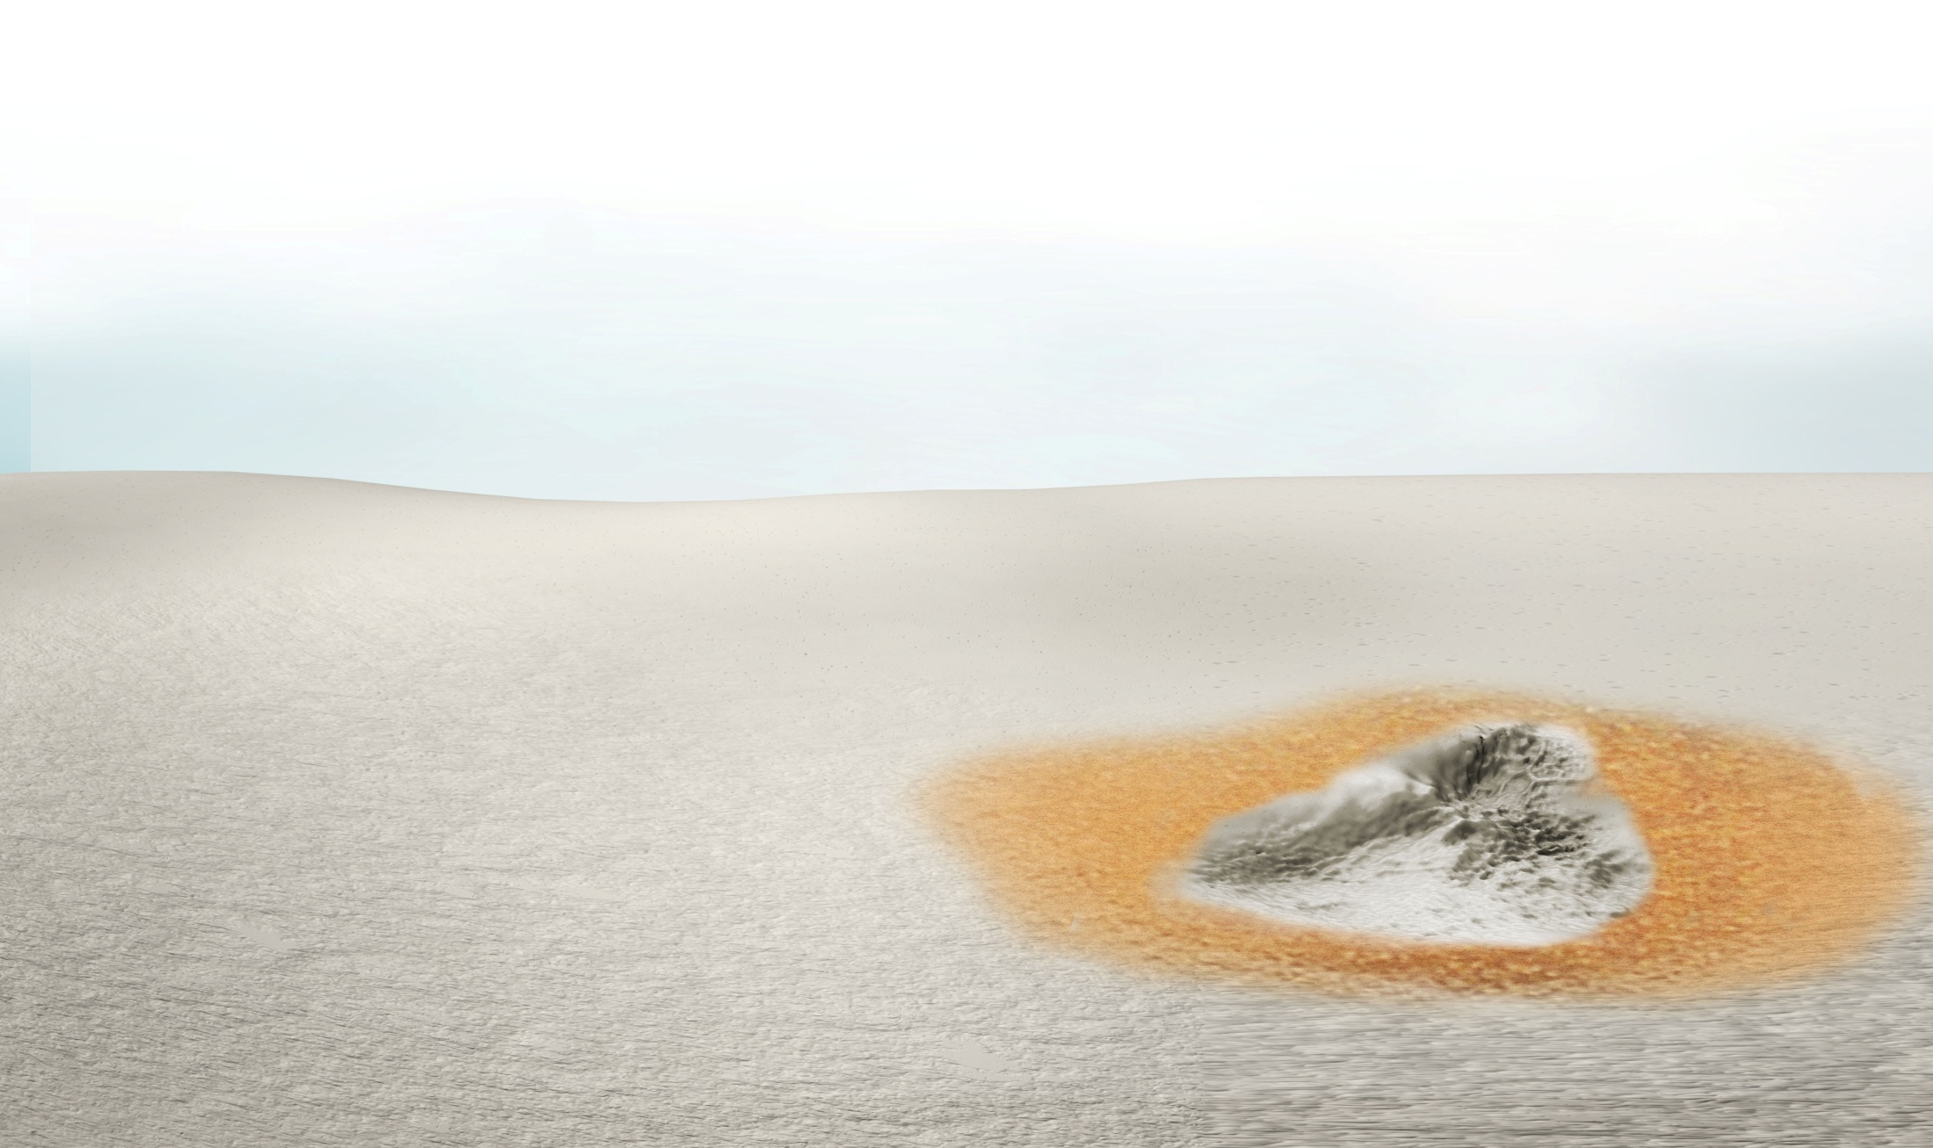



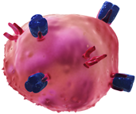













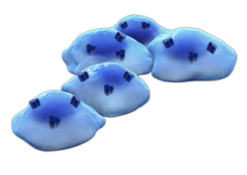

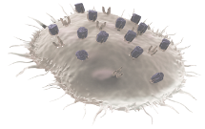



Bisphosphonate binden an den Knochen und hemmen Osteoklasten an der Knochenoberfläche
Osteoklasten-vorläufer
RANK-Ligand
RANK
OPG
Differenzierte Osteoklasten
Bisphosphonat
Bisphosphonate binden an den Knochen und werden von reifen Osteoklasten aufgenommen
1
Aktivierte Osteoklasten
Bisphosphonate hemmen die von Osteoklasten vermittelte Resorption
Osteoblasten
2
Owens G, et al. Am J Manag Care. 2007;13 (suppl)11:S290-S308.
Jung A, et al. Calcif Tissue Res. 1973;11:269-280.
Russell RG, et al. Ann NY Acad Sci. 2007;1117:209-257.
Die Darstellung des Wirkmechanismus dient lediglich illustrativen Zwecken
und ist nicht dazu gedacht, klinische Wirksamkeit zu implizieren.
© 2011 Amgen Inc. Alle Rechte vorbehalten.
Notes:
Bisphosphonates inhibit bone resorption by altering the function of activated osteoclasts.¹⁻⁵
Bisphosphonates bind with high affinity to hydroxyapatite, the main mineral component of bone.⁶
Bisphosphonates localize to regions of bone where new mineral is being deposited beneath osteoblasts and to where bone is being resorbed by osteoclasts.⁷
They are embedded in bone and remain inactive until they are released by the process of osteoclast-mediated bone resorption.^{7,8}
They are then taken up by bone-resorbing osteoclasts by endocytosis.⁷
Internalization of bisphosphonates by osteoclasts results in disruption of the cytoskeleton, loss of osteoclast orientation, and detachment of the osteoclast from the bone surface.¹
Weinstein RS, Roberson PK, Manolagas SC. Giant osteoclast formation and long-term oral bisphosphonate therapy. N Engl J Med. 2009;360:53-62.
Actonel® (risedronate sodium) prescribing information. Procter & Gamble Pharmaceuticals, April 2008.
Boniva® (ibandronate sodium) prescribing information. Roche Therapeutics Inc., November 2008.
Fosamax® (alendronate sodium) prescribing information. Merck & Co, February 2008.
Reclast® (zoledronic acid) injection prescribing information. Novartis Pharma Stein AG, March 2009.
Owens G, Jackson R, Lewiecki EM. An integrated approach: bisphosphonate management for the treatment of osteoporosis. Am J Manag Care. 2007;13(suppl 11):S290-308.
Russell RGG Xia Z, Dunford JE, et al. Bisphosphonates: an update on mechanisms of action and how these relate to clinical efficacy. Ann NY Acad Sci. 2007;1117:209-257.
Sato M, Grasser W, Endo N, et al. Bisphosphonate action: alendronate localization in rat bone and effects on osteoclast ultrastructure. J Clin Invest. 1991;88:2095-2105.

Slide 16












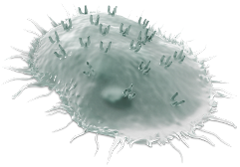
Denosumab (Dmab), ein RANKL-Inhibitor, hemmt Osteoklasten, auch bevor sie sich an den Knochen anlagern*
Osteoklasten-
vorläufer
Dmab blockiert die Bindung von RANKL an RANK
RANK-Ligand
2
RANK
3
Dmab hemmt die Osteoklastenbildung
OPG
Denosumab
Dmab hemmt die Funktion und das Überleben von Osteoklasten
4
Differenzierte Osteoklasten
1
Dmab bindet an RANKL
Aktivierte Osteoklasten
Osteoblasten
*RANK (receptor activator of nuclear factor-κB) ist ein Rezeptor auf der Oberfläche von Osteoklasten und deren Vorläuferzellen. Die Interaktion von RANK mit seinem Liganden RANKL ist essentiell für die Bildung, Funktion und das Überleben von Osteoklasten. Denosumab ist ein monoklonaler Antikörper der an RANKL bindet und dadurch RANKL daran hindert, seinen Rezeptor RANK zu aktivieren; Cummings SR, et al. NEJM 2009;361:756-765;
Aktuelle Fachinformation Prolia®.; Boyle WJ et al. Nature 2003; 423:337–342; Kostenuik PJ. Curr Opin Pharmacol 2005;5 618–625.
.
© 2021 Amgen Inc. Alle Rechte vorbehalten.
Notes:
Prolia™ (denosumab) is the first approved human monoclonal antibody that specifically targets RANK Ligand, an essential mediator of osteoclast formation, function, and survival.¹
Prolia™ is a human IgG2 monoclonal antibody with affinity and specificity for human RANK Ligand. It has an approximate molecular weight of 147 kDa and is produced in genetically engineered mammalian (Chinese hamster ovary) cells.¹
The binding of Prolia™ to RANK Ligand prevents the activation of RANK on the surface of osteoclasts and their precursors.¹
Prevention of the RANKL/RANK interaction inhibits osteoclast formation, function, and survival, thereby decreasing bone resorption and increasing bone mass and strength in both cortical and trabecular bone.¹
Prolia™ (denosumab) prescribing information, Amgen. 2010.

Slide 17
Unterschiede im Wirkmechanismus zwischen
Bisphosphonaten und Denosumab
Bisphosphonate
Binden spezifisch an Hydroxylapatit³
Effekt auf reife Osteoklasten³
Vorwiegend trabekulärer Effekt^{2,4}
Denosumab
Bindet spezifisch an RANKL¹
Effekt auf alle Stadien der Osteoklastendifferenzierung¹
Trabekulärer und kortikaler Effekt^{1,2}
1. Aktuelle Fachinformation Prolia®.
2. Baron R et al. Bone. 2011;48:677-692;
3. Russell RG, et al. Ann NY Acad Sci. 2007;1117:209-257
4. Kimmel et al. J Dent Res 2007;(86):1022-1033

Slide 18
Wirksamkeit von Denosumab an verschiedenen Skelettlokalisationen
Notes:
Key Point
The purpose of this slide deck is to convey the key message that bone disease, in particular osteoporosis, occurs at sites of both trabecular and cortical bone throughout the skeleton; moreover, the effects on these bone sites varies according to the age of the individual, coinciding with changes in the natural composition of bone that develop over time.

Slide 19
HR-pQCT-Untersuchung: Denosumab vs
Alendronat / Placebo - Studiendesign
Einjährige Phase-2 Studie
12 Monate
BEHANSLUNGSENDE
Denosumab 60 mg alle 6 Monate (q6m)
+
Placebo für Alendronat einmal wöchentlich (qw)
SCREENING
BASELINE
Randomisierung
1:1:1
Placebo für Denosumab q6m
+
Alendronat 70 mg qw
Placebo für Denosumab q6m
+
Placebo für Alendronat einmal wöchentlich
HR-pQCT=hochauflösende periphere quantitative Computer Tomographie
Seeman E. et al JBMR 2010;25:1886-1894
Notes:
247 postmenop. women
CSR 20050179 Xtreme CT Study Design. 09/05/2008: 81, A, 1.
CSR 20050179 Primary Objective Study Design. 09/05/2008: 78, A, 1.
CSR 20050179 Study Design. 09/05/2008: 80, Fig 7-1.
New slide

Slide 20
Prozentuale Änderung der kortikalen vBMD
am Radius mittels HR-pQCT gemessen
Einjährige Phase-2 Studie
Zeitliche Änderung
Nach 12 Monaten
1
1
Denosumab
a,c
_{a,c}
a
0,5
Denosumab
Alendronat
Placebo
a
0
0
^{b}
ª
vBMD Änderung (%)
vBMD Änderung (%)
-0,5
Alendronat
-1
-1
Placebo
-1,5
-2
-2
0
6
12
Monate
ªp < 0,001 vs Placebo; ^{b}p = 0,004 vs. Placebo; ^{c}p = 0,023 vs ALN
ANCOVA-Analyse der kleinsten signifikanten Mittelwerte (95% KI)
Seeman E. et al. J Bone Miner Res. 2010 Aug;25(8):1886-94.

Slide 21
Denosumab verhinderte eine Zunahme der kortikalen Porosität am distalen Radius Knochenarchitektur Pilot-Studie (HR-pQCT)
Kortikale Porosität
(Prozentualer Unterschied)
*
Denosumab (n=74)
-2,98
Alendronat (n=69)
+2,86
Placebo (n=72)
+5,19
-5
0
5
* p=0,01 vs. Placebo
Boyd et al. ECTS congress 2011, Abstract und Poster PP264
Zebaze RM et al. Lancet 2010:9727:1729−1736.
Notes:
Key Points:
In the study published by Seeman et al¹, i is hypothesized that the observed improvement in cortical area was produced by a reduction in cortical porosity.
Cortical porosity was evaluated in the compact-appearing cortex of the distal radius at baseline and month 12 from HR-pQCT scans using enhanced method that identifies the cortex with automatic threshold segmentation².
The accuracy³ and reproducibility⁴ of this method have been previously reported. Data were summarized by actual treatment group.
Pores above ~82 μm were identifiable
Cortical porosity was expressed as percent of the total cortical volume
Treatment effect was estimated²
As this was a pilot study, no formal statistical hypothesis was performed a priori; p values were calculated ad hoc
Study limitations
Porosity may have been underestimated with the automated segmentation method used, particularly in the setting of a low-density cortex.
The method only allowed for resolution of pores above ~82μm
The transition zone (the zone between trabecular bone and the compact-appearing cortex) may not have been accurately identified with the automated segmentation method used
References
Seeman E, Delmas PD, Hanley DA, et al. Microarchitectural deterioration of cortical and trabecular bone: differing effects of denosumab and alendronate. J Bone Miner Res. 2010;25:1886-1894.
Boyd et al. ECTS congress 2011, abstract and poster PP264
Nishiyama KK et al J Bone Miner Res. 2010; 25:882-90
Burghardt AJ et al Bone. 2010; 47:519-28

Slide 22
Größere BMD-Zunahme mit Denosumab vs. Alendronat an allen gemessenen Stellen
Phase-3-Studie (DECIDE)
KORTIKAL
TRABEKULÄR
6
26%*
5
Alendronat 70 mg p.o. qw
35%*
Denosumab 60 mg s.c. q6m
4
* Relativer Unterschied der BMD-Änderung
berechnet aus den absoluten Zahlen
Änderung der BMD vs. Ausgangswert (%)
3
2
83%*
1
0
Lendenwirbelsäule
Gesamthüfte
distaler Radius
Brown JP et al. J Bone Miner Res 2009; 24 153–161

Slide 23
Größere BMD-Zunahme mit Denosumab vs. ALN bei ALN-vorbehandelten Frauen an allen gemessenen Stellen Phase-3-STAND-Studie
KORTIKAL
TRABEKULÄR
Lendenwirbel
(sekundärer Endpunkt)
Hüfte Gesamt
(primärer Endpunkt)
1/3 Radius
(sekundärer Endpunkt)
2,4
#
4,0
2,2
3,5
#
2,0
1,6
1,8
*
1,4
3,0
1,6
1,2
2,5
*
1,4
1,0
*
Änderung der BMD vs. Baseline (%)
(Mittelwerte der kleinsten Quadrate, 95% CI)
1,2
2,0
1,0
0,8
1,5
0,8
0,6
1,0
0,6
0,4
0,5
0,4
0,2
0,2
0,0
0,0
0,0
0
6
12
0
6
12
0
6
12
Studienmonat
Studienmonat
Studienmonat
*p ≤ 0,01
#p < 0,0001
*p < 0,05
#p < 0,0001
*p = 0,0121
n = Anzahl an Patienten, die eine Baseline- und ≥ 1 Evaluation danach haben
Kendler DL, et al. J Bone Miner Res. 2010;25:72-81
Denosumab 60 mg q6m (n = 246)
Alendronat 70 mg qw (n = 241)
Notes:
23
Significantly greater gains in BMD were observed at month 12 at the lumbar spine, femoral neck, and one-third radius with denosumab therapy than with alendronate therapy.
Kendler DL, et al. J Bone Miner Res. 2008;23(suppl 1):S473. Abstract M395 and poster.
*

Slide 24

Denosumab reduziert nach 36 Monaten das Frakturrisiko an allen relevanten Lokalisationen
Phase-3-Studie (FREEDOM)
RR = 20%
p = 0,01
Placebo
9%
Denosumab
RR = 68%
p < 0,001
8%
8,0%
7%
7,2%
6%
6,5%
5%
Inzidenz nach 36 Monaten (%)
4%
3%
RR = 40%
p = 0,04
2%
2,3%
1%
1,2%
0,7%
0%
Neu vertebrale
Frakturen
Nicht-vertebrale
Frakturen
Hüftfrakturen
RR = Risikoreduktion
Cummings SR, et al. N Engl J Med. 2009;361:756-765.
Notes:
In the analysis of the primary endpoint, the relative risk of new vertebral fractures was
0.32 (95% confidence interval [CI]: 0.26–0.41) for denosumab vs placebo, representing a 68% reduction (P < 0.001).¹
The percentages of new and multiple new vertebral fractures are calculated for
3,702 subjects in the denosumab group and 3,691 in the placebo group who underwent spinal radiography at baseline and during ≥ 1 visit after baseline.
The percentage of nonvertebral, hip, and new clinical vertebral fractures are cumulative Kaplan-Meier estimates for 3,902 subjects in the denosumab group and 3,906 in placebo group.
The hazard ratio of denosumab vs placebo was¹:
0.80 (95% CI: 0.67–0.95) for nonvertebral fractures, representing a 20% reduction
(P = 0.01)
0.60 (95% CI: 0.37–0.97) for hip fractures, representing a 40% reduction (P = 0.04)
[Not shown] 0.31 (95% CI: 0.20–0.47) for new clinical vertebral fractures, representing a 69% reduction (P < 0.001) [Note: clinical vertebral fracture is different from the primary endpoint vertebral fracture]
[Not shown] 0.39 (95% CI: 0.24–0.63) for multiple new clinical vertebral fractures, representing a 61% reduction (P < 0.001)
Analysis of efficacy was based on intent-to-treat principle.¹
The study was designed to maintain an overall significance level at 0.05 despite the multiple comparisons.¹
Statistical significance of the primary endpoint was required before the secondary
and other fracture endpoints would be analyzed.
The absolute risk reduction was calculated based on the difference in incidence at month 36 for the primary endpoint.
The difference in the Kaplan-Meier estimates at month 36 was used to calculate the absolute risk reduction for the secondary endpoints.
Cummings SR, San Martin J, McClung MR, et al. Denosumab for prevention of fractures in postmenopausal women with osteoporosis. N Engl J Med. 2009;361:756-765.

Slide 25
Reduktion des Frakturrisikos im gesamten Skelett bei allen Altersstufen
Phase-3-Studie (FREEDOM): Post-hoc-Analyse nach Alter
Vertebrale Frakturen
Hüftfrakturen
10%
p _{Interaktion} = 0,4822
p _{Interaktion} = 0,0714
RR = 64%
p < 0,001
9%
8%
RR = 70%
p < 0,001
8,6%
7%
6%
6,5%
Inzidenz nach 36 Monaten (%)
Allgemeine Inzidenz
5%
Vertebrale Fraktur
4%
Hüftfraktur
RR = 62%
p = 0,0065
3%
Behandlung
3,0%
RR = 6%
p = 0,8490
Placebo
2%
2,0%
2,3%
Denosumab
1%
0,7%
0,6%
0,9%
0%
60 bis 74
75 bis 90
60 bis 74
75 bis 90
60 bis 74 Jahre
75 bis 90 Jahre
60 bis 74 Jahre
75 bis 90 Jahre
Jahre
RR = Risikoreduktion; *In die FREEDOM Studie wurden Frauen im Alter von 60 bis 90 Jahre eingeschlossen
Verändert nach: Rizzoli R. et al. Osteoporosis Intl Supl 2010 – poster P841; Sambrook P & Cooper C. Lancet 2006;367:2010-2018
Aktuelle Fachinformation Prolia®. ; Boonen S et al. J Clin Endocrinol Metab 2011; 96(6): 1727–1736
Notes:
In the analysis of the primary endpoint, the relative risk of new vertebral fractures was
0.32 (95% confidence interval [CI]: 0.26–0.41) for denosumab vs placebo, representing a 68% reduction (P < 0.001).¹
The percentages of new and multiple new vertebral fractures are calculated for
3,702 subjects in the denosumab group and 3,691 in the placebo group who underwent spinal radiography at baseline and during ≥ 1 visit after baseline.
The percentage of nonvertebral, hip, and new clinical vertebral fractures are cumulative Kaplan-Meier estimates for 3,902 subjects in the denosumab group and 3,906 in placebo group.
The hazard ratio of denosumab vs placebo was¹:
0.80 (95% CI: 0.67–0.95) for nonvertebral fractures, representing a 20% reduction
(P = 0.01)
0.60 (95% CI: 0.37–0.97) for hip fractures, representing a 40% reduction (P = 0.04)
[Not shown] 0.31 (95% CI: 0.20–0.47) for new clinical vertebral fractures, representing a 69% reduction (P < 0.001) [Note: clinical vertebral fracture is different from the primary endpoint vertebral fracture]
[Not shown] 0.39 (95% CI: 0.24–0.63) for multiple new clinical vertebral fractures, representing a 61% reduction (P < 0.001)
Analysis of efficacy was based on intent-to-treat principle.¹
The study was designed to maintain an overall significance level at 0.05 despite the multiple comparisons.¹
Statistical significance of the primary endpoint was required before the secondary
and other fracture endpoints would be analyzed.
The absolute risk reduction was calculated based on the difference in incidence at month 36 for the primary endpoint.
The difference in the Kaplan-Meier estimates at month 36 was used to calculate the absolute risk reduction for the secondary endpoints.
Cummings SR, San Martin J, McClung MR, et al. Denosumab for prevention of fractures in postmenopausal women with osteoporosis. N Engl J Med. 2009;361:756-765.

Slide 26
Hüftfrakturrisiko bei älteren Patienten
Es handelt sich um einen indirekten Studienvergleich; die angegebenen Daten stammen aus unterschiedlichen Studien mit verschiedenen Patientenkollektiven.
Wirkstoff | Studie (n) | Patientenalter (n) | Relative Risikoreduktion (p-Wert; *signifikant)
Denosumab | FREEDOM (7868)¹ | ≥ 75 (2471)² | 62 %* (0,007)
Zoledronat | HORIZON RFT + PFT(9892)³ | ≥ 75 (3888)³ | 18 % (0,297)
Risedronat§ | HIP (9331)⁴ | 70-79 (5445)⁴ | 40 %* (0,009)
 | HIP (9331)⁴ | ≥ 80 (3886)⁴ | 20 %
Strontium-ranelat | TROPOS (5091)⁵ | ≥ 74 (1977)⁵ | 36 %* (0,046)
 | TROPOS/SOTI (6740)⁶ | ≥ 80 (1488)⁶ | 32 % (0,112)
Alendronat | Keine Auswertung bei älteren Patienten
Ibandronat | Keine Hüftfrakturdaten verfügbar°^{,7}
Raloxifen | Keine Hüftfrakturdaten verfügbar^{#,8}
PTH | Keine Hüftfrakturdaten verfügbar^{&,9}
(0,35)
§ Fachinformation Actonel 35 mg: 46 % RRR für Hüftfrakturen in einer Subgruppenanalyse (Alter 70-100; T-Score am Schenkelhals <-2,5; ≥ 1 prävalente vertebrale Fraktur); „… die Daten lassen vermuten, dass demgegenüber bei sehr alten Patienten (≥80 Jahre) ein geringerer Schutz beobachtet werden könnte.“
°„Eine Reduktion des Risikos vertebraler Frakturen wurde gezeigt, eine Wirksamkeit hinsichtlich Oberschenkelhalsfrakturen ist nicht ermittelt worden.“ 7
# „Es wurde eine signifikante Verminderung in der Inzidenz von vertebralen Frakturen, aber nicht von Hüftfrakturen, nachgewiesen.“ 8
&„Bei postmenopausalen Frauen wurde eine sig . Reduktion der Inzidenz vertebraler und extravertebraler Frakturen, aber nicht von Hüftfrakturen, nachgewiesen.“ 9
1. Cummings SR, et al. N Engl J Med 2009, 361:756-765; 2. Boonen S et al. J Clin Endocrinol Metab 2011;96(6):1721-736; 3. Boonen S et al. J Am Geriatr Soc. 2010;58(2):292-299; 4. McClung M et al., N Engl J Med 2001, 344:333-340; 5. Reginster JY et al., J Clin Endocrinol Metab 2005, 90: 2816–2822; 6. Seeman E et al., J Bone Miner Res 2006, 21:1113–1120; 7. Fachinfo Bonviva 3mg Injektionslösung; November 2011; 8. Fachinfo Evista; April 2012; 9. Fachinfo Forsteo; Februar 2013;

Slide 27
FREEDOM:
Auswertung bei Frauen ≥ 75 Jahre
Signifikante Reduktion von Hüftfrakturen bereits nach 1 Jahr
4
Placebo (N = 1236)
RRR = 62%*
Denosumab (N = 1235)
ARR = 1,4 (0,4; 2,5)
3
ARR = 1,4 (0,5; 2,3)
2
ARR = 0,9 (0,2; 1,6)
Patienten mit Hüftfraktur (%)
1
0
0
6
12
18
24
30
36
Studienmonat
RRR = relative Risikoreduktion über 36 Monate; ARR = absolute Risikoreduktion (95% KI).
*p = 0,0065
Boonen S et al. J Clin Endocrinol Metab 2011; 96(6): 1727–1736

Slide 28
Studiendesign
FREEDOM-Verlängerungsstudie
FREEDOM
Verlängerung
Jahre
0
1
2
3
4
5
6
7
8
9
10
R
A
N
D
O
M
I
S
I
E
R
U
N
G
Denosumab 60 mg
s.c. Q6M
(N = 2343)
Denosumab 60 mg
s.c. Q6M
(N = 3902)
Langzeit
Gruppe
Calcium and Vitamin D
Placebo
s.c. Q6M
(N = 3906)
Denosumab 60 mg
s.c. Q6M
(N = 2207)
Cross-over
Gruppe
1
2
3
4
5
6
7
s.c.: subkutan; Q6M: alle 6 Monate
Adaptiert nach Bone HG, et al. Lancet Diabetes Endocrinol. 2017;5(7):513-523.

Slide 29
Veränderung der Knochenmineraldichte über 10 Jahre
Placebo (n=3906)
Cross-over Denosumab (n=2207)
Langzeit-Gruppe Denosumab (n=2343)
Lendenwirbelsäule
Gesamthüfte
24
b
10
FREEDOM
Verlängerung
b
22
FREEDOM
Verlängerung
21,7%
b
9,2%
20
b
8
b
18
b
b
b
b
b
16
b
b
16,5%
6
a
14
b
a
b
7,4%
12
a
b
BMD-Änderung vs. Baseline (%)
b
BMD-Änderung vs. Baseline (%)
4
a
10
a
b
b
8
b
a
b
6
a
2
a
4
a
a
a
a
2
a
a
0
0
a
–2
–2
0
1
2
3
4
5
6
7
8
9
10
0
1
2
3
4
5
6
7
8
9
10
Jahre
Jahre
ªp < 0,05 verglichen mit der FREEDOM Baseline. ^{b}p< 0,05 verglichen mit der FREEDOM und der Verlängerungs Baseline
BMD = Knochenmineraldichte
Bone HG, et al. Lancet Diabetes Endocrinol. 2017;5(7):513-523.

Slide 30
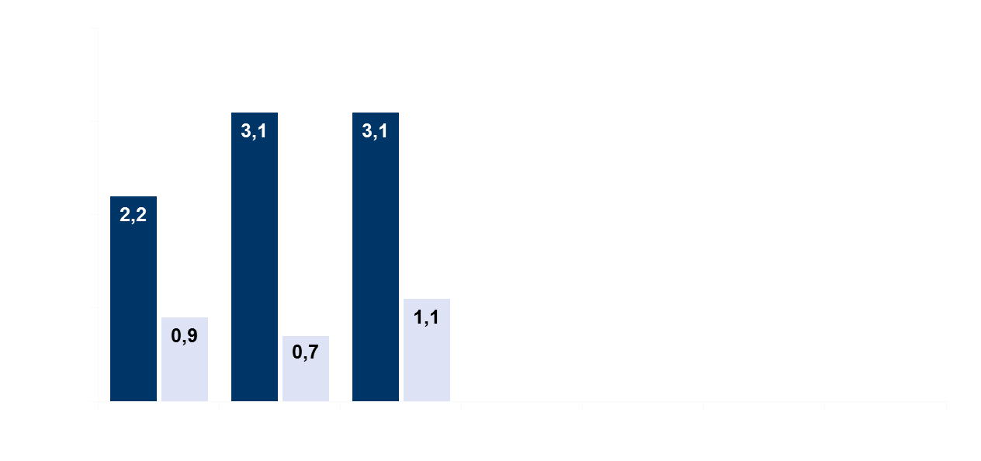
Jährliche Inzidenz neuer vertebraler Frakturen
Placebo (n=3906)
Langzeit-Gruppe Denosumab (n=2343)
FREEDOM
Verlängerung
Jährliche Frakturinzidenz (%)
1,5
1,4
1,2
1,3
ª
ª
ª
Jahre
ªAnnualisierte Inzidenz: (2-Jahresinzidenz / 2) radiologische Untersuchungen in den Jahren 5, 6, 8 und 10
Adaptiert nach: Bone HG, et al. Lancet Diabetes Endocrinol. 2017;5(7):513-523.
Notes:
The primary endpoint of the open-label extension study was safety and tolerability of denosumab for up to 10 yrs. Fractures were collected as AEs in this study.

Slide 31

Jährliche Inzidenz Hüftfrakturen
Placebo (n=3906)
Langzeit-Gruppe Denosumab (n=2343)
FREEDOM
Verlängerung
Jährliche Frakturinzidenz (%)
0,4
0,2
0,2
0,2
0,1
0,1
0,0
Jahre
Adaptiert nach Bone HG, et al. Lancet Diabetes Endocrinol. 2017;5(7):513-523.
Notes:
The primary endpoint of the open-label extension study was safety and tolerability of denosumab for up to 10 years.

Slide 32

Jährliche Inzidenz nicht-vertebraler Frakturen
Placebo (n=3906)
Langzeit-Gruppe Denosumab (n=2343)
FREEDOM
Verlängerung
Jährliche Frakturinzidenz (%)
1,8
1,9
1,5
1,6
1,2
1,1
0,8
Jahre
Adaptiert nach: Bone HG, et al. Lancet Diabetes Endocrinol. 2017;5(7):513-523.
Notes:
The primary endpoint of the open-label extension study was safety and tolerability of denosumab for up to 10 yrs. Fractures were collected as AEs in this study.

Slide 33
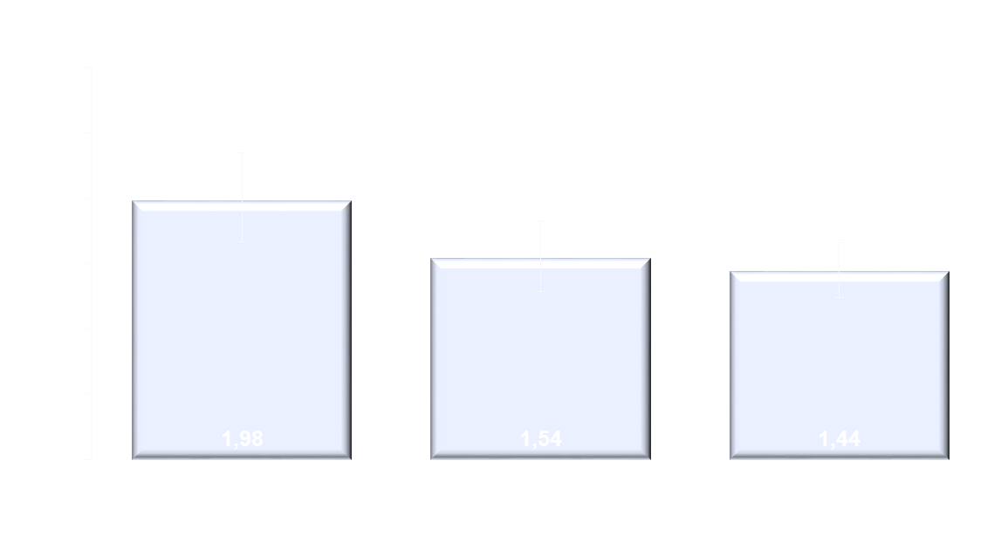
Nicht-vertebrale Frakturen über 10 Jahre
Rate Ratio (95% KI) = 0,74 (0,60–0,93)
p = 0,008
Rate Ratio (95% KI) = 0,79 (0,62–1,00)
p = 0,046
Frakturrate pro 100 Patienten-Jahre (95% KI)
N = 2343
Jahre 1-3
Jahre 4-7
Jahre 4-10
► Denosumab führt zu einer weiteren Reduktion nicht-vertebraler Frakturen in den Jahren 4-10 im Vergleich zu den ersten 3 Jahren.
Ferrari et al. 2017; J Bone Miner Res; 32(Suppl1):#1073 Vortrag
N = Anzahl an Teilnehmerinnen, die nicht mehr als eine Dosis Denosumab während der FREEDOM-Studie ausgelassen haben und die in die Verlängerung mitaufgenommen wurden.

Slide 34
Unerwünschte Ereignisse
 | FREEDOM Jahre 1-3 Denosumab¹ n=3879 Häufigkeit# (n) | FREEDOM Jahre 1-3 Placebo¹ n=3883 Häufigkeit# (n) | Verlängerung Jahr 10 Denosumab² n=1454 Häufigkeit# (n)
Alle unerwünschten Ereignisse | 154,5 | 156,1 | 95,9
Infektionen | 29,3 | 30,7 | 23,0
Malignome | 1,8 | 1,6 | 1,6
Ekzeme | 1,1 | 0,6 | 1,3
Hypokalzämie | 0 | < 0,1 | 0,1
Pankreatitis | < 0,1 | < 0,1 | 0
Schwerwiegende unerwünschte Ereignisse | 10,6 | 10,4 | 12,3
Infektionen | 1,5 | 1,3 | 2,6
Zellulitis* oder Erysipele | 0,1 | < 0,1 | 0,1
Kieferosteonekrosen | 0 | 0 | 0,9
Atypische Femurfraktur | 0 | 0 | < 0,1
Todesfälle | 0,6 | 0,8 | 0
#pro 100 Patienten-Jahre
*Entzündung des Unterhautgewebes
1. Papapoulos S, et al. Osteoporos Int. 2015;26(12):2773-83, Supplementary material ESM1.
2. Bone HG, et al. Lancet Diabetes Endocrinol. 2017;5(7):513-523.

